Slide 1
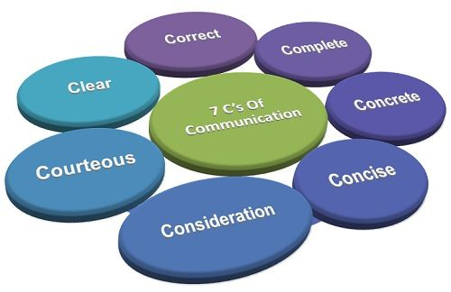
Principles of effective communication

Slide 2
At the end of the class, In their business messages, the students will be able to bring:
Completeness
concreteness,
Consideration
courtesy

Slide 3
The Seven C’s of Effective Communication
To compose effective written or oral messages, you must apply certain communication principles. These principles provide guidelines for choice of content and style of presentation, adapted to the purpose and receiver of your message. Called the “seven C’s,” they are completeness, conciseness, consideration, concreteness, clarity, courtesy, and correctness.
The 7 Cs provide a checklist for making sure that your meetings, emails, conference calls, reports, and presentations are well constructed and clear – so your audience gets your message.

Slide 4
1. COMPLETENESS
Business message is said to be complete when it contains all facts the reader or listener needs for the reaction the sender desires.
As you strive for completeness, keep the following guidelines in mind;
Provide all necessary information. Otherwise it will create suspicion.
Answer all questions asked.
Give something extra when desirable

Slide 5
1.COMPLETENESS
Provide All Necessary Information
Answering the five W’s helps make messages clear: Who, What, When, Where, and Why.
Answer All Questions Asked (W & H, Implied, stated)
Look for questions: some may appear and some are buried within a paragraph.
Locate them and then answer precisely.
Give Something Extra, When Desirable
Use your good judgment in offering additional material if the sender’s message is incomplete.

Slide 6
COMPLETENESS: Tips
1. If you want your client to book a hotel accommodation for you, you should tell him/her what your needs are, where you want it; when you want it and how you are going to pay for it etc.
2. When you tell your subordinate to go to the airport to receive someone, you should tell him/her at what time, who the person to be received is, and where he should be taken to etc. This is completeness.
3. Completeness prevents the need for further communication, amending, elaborating and expounding (explaining) the first one and thus saves time and resource.

Slide 7
EXAMPLES FOR COMPLETENESS
Incomplete:
1. I did not receive any response for the complaint I lodged.
Complete:
I made a complaint to the Branch Manager on June 23, 2003 on the inordinate delay at the cash counter. Can I get a response please?
Incomplete;
2. I want a room booked at your hotel for three days in the first week of the month of July.
Complete;
I will be arriving on July 3rd morning by Pandora Express. I want a single room accommodation for three days from 23rd Feb 2021, morning time. I want a room with attached toilet, running hot water facility and telephone (if available). Kindly do the booking in my name. My details are as under:

Slide 8
Bad example:
Hi all,
Let us meet tomorrow to discuss the product launch event. Please be there on time.
Thanks A.B.C.
(There is no mention of the time of the meeting scheduled for, or the location, neither is there any set agenda. The recipients of the email would have to write back or call back to Chris to clarify).
Good example:
The best way to have written this email is:
Hi all,
Let us meet tomorrow at 11am at Conference room 3 to discuss the product launch event. We will have to decide the keynote speakers and complete the event invite draft tomorrow. Please be there on time.
Thanks A.B.C.

Slide 9
COMPLETENESS: Sample questions
Use five W,s method to complete the given tasks.
Task 1.
Write an email to the admin officer of the ABC Banquet to reserve it for your brother`s marriage. Keep in mind the requirements of completeness while requesting.
Task 2
Write an email to request/order merchandise (goods) for your ABC mart. (Mention when you need it, how and when it would be transported and to whom it would be delivered and how the payment will be made)
Task 3. Revise the given sentences to bring completeness.

Slide 10
COMPLETENESS: Sample questions
You are the president of an industry association and
have received the following inquiry from an out of town
member, “I think I would like to attend my first meeting
of the association, even though I am not acquainted
with your city. Will you please tell me where the next meeting is being held?
How would you reply to this letter keeping in mind
Completeness of the message?

Slide 11
CONCRETENESS
Communicating concretely means being specific, definite, and vivid rather than vague and general. Often it means using denotatives (direct, explicit, dictionary based) rather than connotative words (ideas or notions suggested by or associated with a word or phrase).

Slide 12
CONCRETENESS
The following guidelines should help you compose concrete, convincing message;
Use specific facts and figures, and precise words.
Put action in your verbs.
Choose vivid, image building words.

Slide 13
CONCRETENESS
Use Specific Facts and Figures
It is desirable to be precise and concrete in both written and oral business communication. Avoid vagueness. Commercialese (Business Jargon), cliché now.
Vague, General, Indefinite Students’ GMAT scores have risen.
Concrete, Precise
In 1996, the GMAT
scores averaged 600; by 1997 they had risen to 610.

Slide 14
CONCRETENESS
Cut the deadwood
Replace dead words with more effective and precise words.
Do not say the following:
I am slightly unwell. (You can be unwell or not. How can any sickness be slight ?).
2. Interest rates have been marginally reduced. (Say precisely the quantum of reduction).
What is marginal to the finance minister may be huge to a person depending on interests.

Slide 15
CONCRETENESS
Use active voice.
You should say “our team won the match”, rather than “The match was won by our team”.
Do not say “We expect daily reports,” but say “You should send daily reports”.
In rare cases, where you do not want to sound authoritarian, you may use the passive voice. i.e. “Smoking is prohibited.”

Slide 16
CONCRETENESS
Occasionally, to achieve concreteness you can use idioms / phrases to project a vivid image.
The following sentences provide concrete images.
“Our Foreman is a human dynamo”.
“He treats brickbats as bouquets”
“John is the Casabianca of our group

Slide 17
Exercise
Rewrite the following in concrete form as the sentences are too general and vague.
This printer prints campaign letters fast
Our product has won several prizes.
These brakes stop a car within a short distance.

Slide 18
Exercise
Put action into the words by using active instead of passive voice.
Tests were made by us
A full report will be sent to you by the supervisor.
Consideration to the report will be given by Mr. Singh ….

Slide 19
COURTESY
Be aware of perspectives and feelings of others.
Hold a sincere you-attitude. Hidden insults and aggressive tones cause troubles and result in reduced morale and productivity.
Following are the suggestions for generating a courteous tone;
Be sincerely tactful, thoughtful, and appreciative.
Use expressions that show respect.
Choose nondiscriminatory expressions.

Slide 20
Be Sincerely Tactful, Thoughtful, and Appreciative
 Though few people are intentionally abrupt or blunt, these negative traits are a common cause of discourtesy.
Tactless, Blunt
More Tactful
Stupid letter; I can’t
understand any of it.
Clearly, you did not read my latest fax.
It’s my understanding…
Sometimes my wording is not precise; let me try again

Slide 21
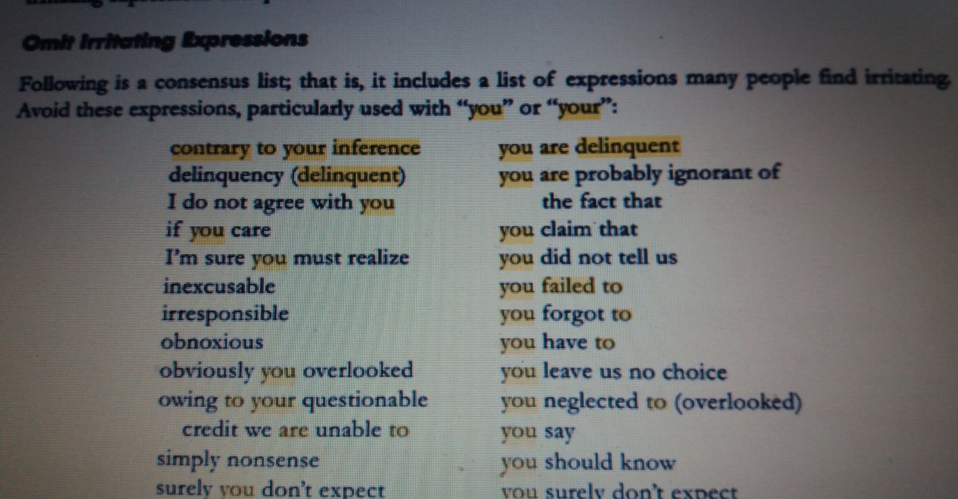
DON`T USE FOLLOWING EXPRESSIONS

Slide 22
Choose Nondiscriminatory Expressions
Use nondiscriminatory language that reflects equal treatment of people regardless of gender, race, ethnic origin, and physical features.
Questionable
More Desirable
Freshman
Entering students; first year student.
Workers; employees; work force personnel
Manpower

Slide 23
Exercise
Show courtesy by avoiding tactless & blunt language from the following message.
Your letter is not clear at all:
Obviously, if you would read your policy carefully you will be able to answer these questions yourself.
Apparently you already forgotten what I wrote you two weeks ago.

Slide 24
Exercise
Use gender friendly substitutes
Mankind
The best man for the job
Manmade
Manpower
Businessman
Sales man
Chairman

Slide 25
You guys should all be concerned about the issue. Each manger has an assigned place – he should park his car…. Each customer will have change noted on his bill
Exercise

Slide 26
CONSIDERATION
Consideration means preparing every message with the message receivers in mind; try to put yourself in their place.
Do not lose your temper. Do not accuse and do not charge them without facts.
The thoughtful consideration is also called “you-attitude”.
Focus on “You” instead of “I” and “We”.
Show audience benefit or interest in the receiver.
Emphasize positive and pleasant facts.
Visualize readers` problems, desires, emotions and response.

Slide 27

Focus on “You” Instead of “I” or We”
Using “you” does help project a you-attitude. But overuse can lead to a negative reaction.
We-Attitude: I Am delighted to announce that we will be extending our hours to make shopping more convenient.
You-Attitude: You will be able to shop in the evenings with the extended hours.

Slide 28
Show Audience Benefit and/or create Receiver`s interest.
Reader may react positively when benefits are shown to them.
Benefits must meet recipients needs, address their concerns,
or offer them rewards.
Most important is that these must be perceived as benefits by
the receivers.

Slide 29
Exercise
Rewrite the following with a “you” attitude; it shows consideration.
I want to send my congratulations for ---
We will ship soon the goods of your May 4 order—
We pay eight percent interest on -----

Slide 30
Emphasize positive, pleasant facts.
Negative- Unpleasant | Positive - Pleasant
It is impossible to open an account for you today. | As soon as your signature card reaches us, we will gladly open an account
We do not refund if the returned item is soiled and unsalable. | We refund when the returned item is clean and resalable.
When you travel on company expense, you will not receive approval for first class fare. | When you travel on company expense, your approved fare is for tourist class.

